Slide 1
by Michał Grabicki
„Toss and die”

Slide 2
TASK 1
Problem
Your colleague from accounting has asked you to find a way to group players. She would like to assign to each group an assistant. Find the most optimal number of assistants (each additional assistant generates additional costs) taking into account their similar **age** and **distance in x and y** from the headquaters

Slide 3
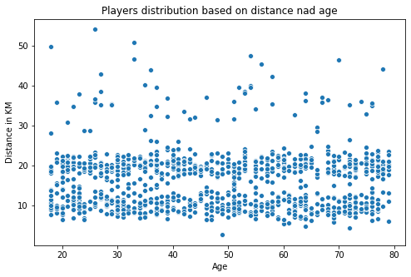
Distance had to be converted from coordinate system into distance in KM from players location to the headquarters.
The distribution of players based on distance and age clearly shows an even distribution both in distance and age varieble.

Slide 4
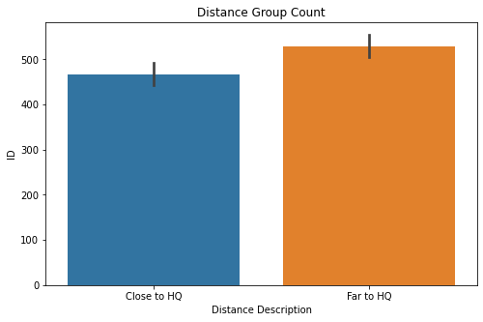
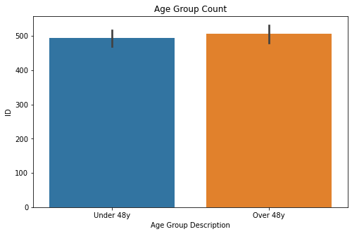
Players were divided into two distinguish groups based on distance to headquarters.”close to hq” means that the player is based closer than 16.47km from hq and „Far to hq” means further than 16.47km. Mean value of distance was used as a dividing point.
Players were also divided into two distinguish groups based on age. Mean value (48) of age was used as a dividing point.

Slide 5
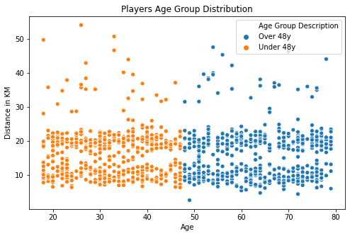
The distribution of players based on distance and age clearly shows an even distribution within different age groups.

Slide 6
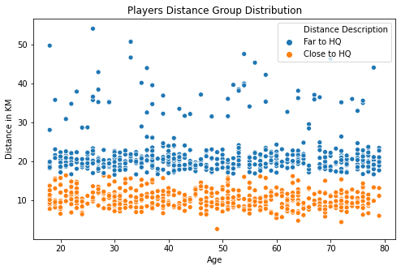
The distribution of players based on distance and age clearly shows an even distribution within different distance groups.

Slide 7
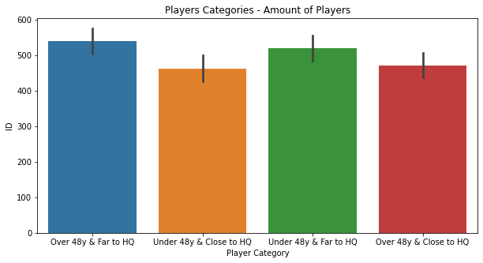
Conclusion:
AS A RESULT, player categorization based on age and distance from the headquarters WAS INTRODUCED WITH EACH CATEGORY HAVING APPROXIMATELY THE SAME NUMBER OF PLAYERS.
File with Categorization is attached to the presentation.

Slide 8
TASK 2
Problem
Your colleague has noticed that some players might be cheating. He asked you to verify a particular age group (<25 years) and present your results. Hint: showing all the possible combinations in a fair game might help.

Slide 9
Results of players under 25 years old were extracted for this exercise.
The table shows the results matrix with all possible outcomes of the game displayed.
 |  | Results Matrix
 |  | Dice point | Dice point | Dice point
 |  | 1 | 2 | 3
Dice point | 1 | 2 | 3 | 4
Dice point | 2 | 4 | 4 | 5
Dice point | 3 | 4 | 5 | 6
Dice point (for the tails coin toss) | 0 | 1 | 2 | 3

Slide 10
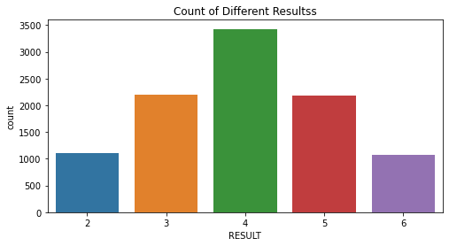
The count of each result of games for the age group under 25 years old. In neither of games the result was equal to 1.

Slide 11
Conclusion:
In the given sample there were 10,000 games for the age group below 25 years.
Statisticaly the number of games resulted in one point would be equal 833.
Result = 1 can be achived only by single dice roll.
this indicates that the cheat accures during the coin toss (tails is never the result of the coin toss).
 | Probability Matrix
Result | Number of combinations | Probability
1 | 1 | 8.33%
2 | 2 | 16.67%
3 | 2 | 16.67%
4 | 4 | 33.33%
5 | 2 | 16.67%
6 | 1 | 8.33%
Total | 12 | 100%

Slide 12
TASK 3
Problem
game_2.csv is a list of the results in another game offered by the company. The rules of the game are not important for this task. Another colleague of yours introduced two months ago a special discount for people over 50 years old and suspects that the recent increasing trend in number of games per day is caused by this discount. She asked you to find that trend and to verify whether her idea had any impact on this or not.

Slide 13
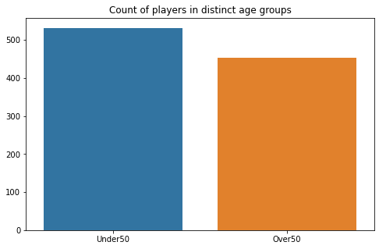
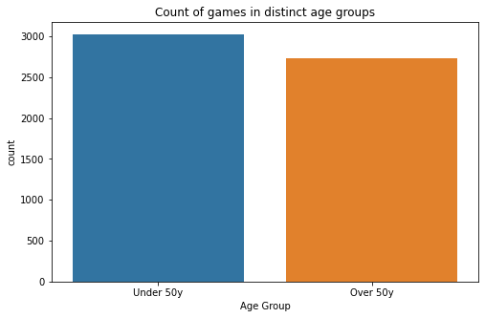
Players where devided into seperate age groups. Over and under 50 years old.
The data set is quite balanced, meaning that both age groups have similar amount of players and number of games played.
We can therefore observe any deviation from the trend for the group over 50y/o comparing it to the group under 50y/o.

Slide 14
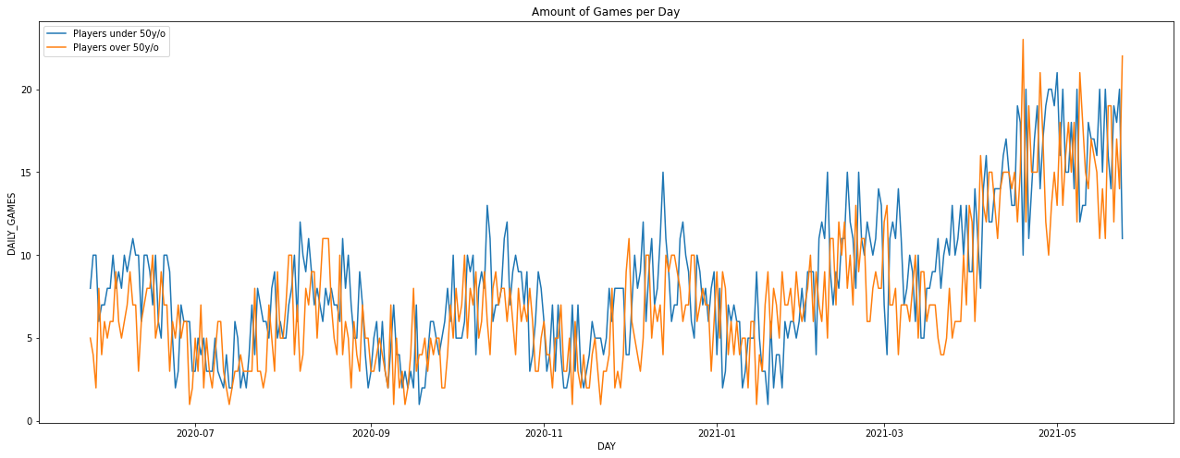
The Data has been aggregated to display amount of games per day.
The data fluctuates a lot therefore we cannot see the clear trend.

Slide 15
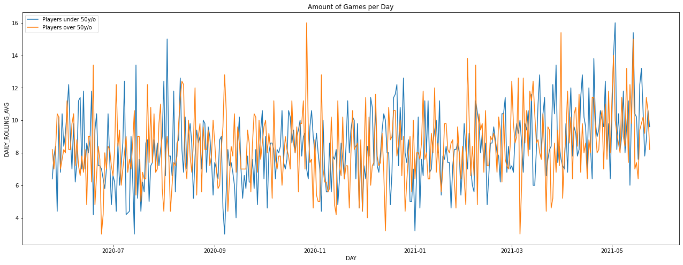
The same occurs after applying the rolling average.
The data fluctuates too much so we cannot see the clear trend.

Slide 16
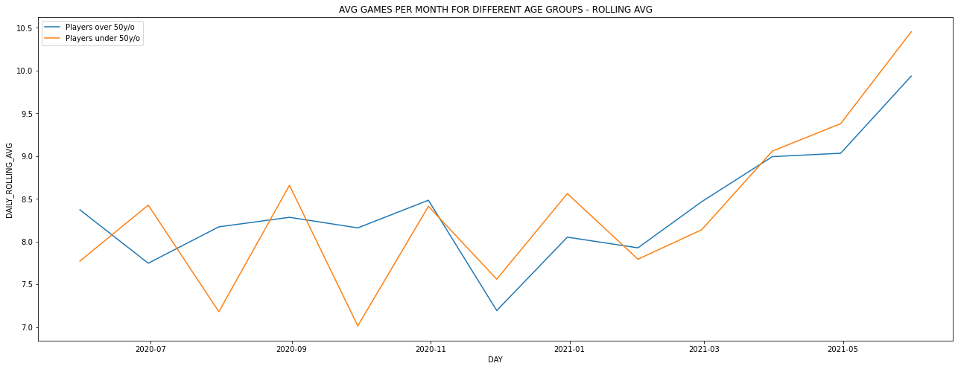
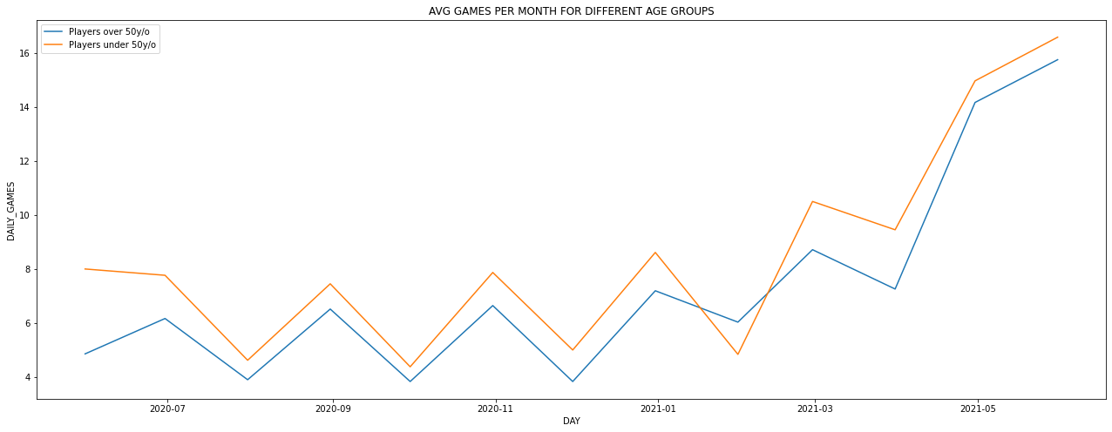
The data was further aggregated to display amount of games per month.
conclusion:
This time we can observe that there is no clearly deviation of the trend of numer of games played by Players over 50 y/o compared to the trend of numer of games played by Players under 50.
the spike of numbers of daily games in last two months occurs in all age groups. The introduced special discount has no clear impact on the number of games.

